Slide 1
Hierarchy Of Exceptions In Java
momedaram

Slide 2
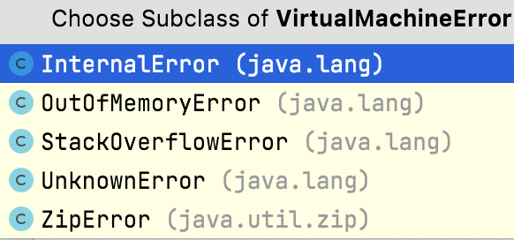
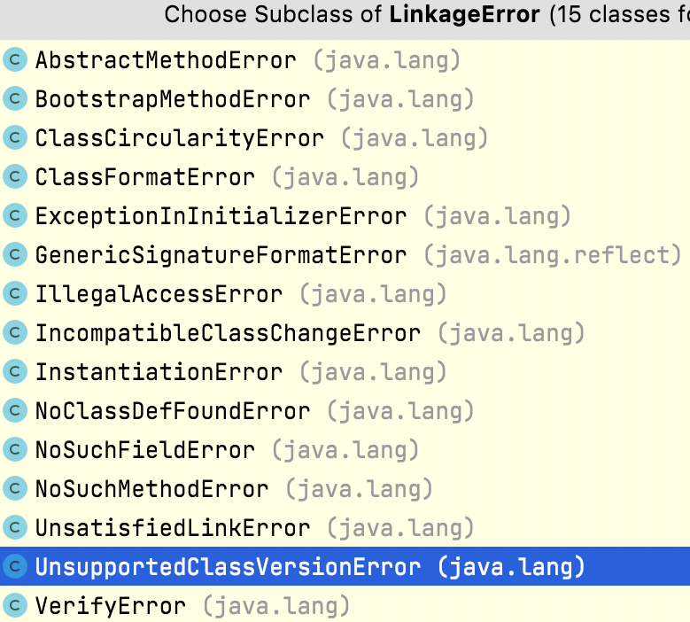
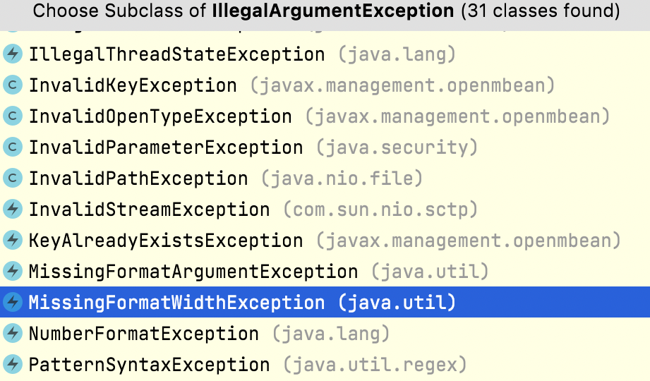
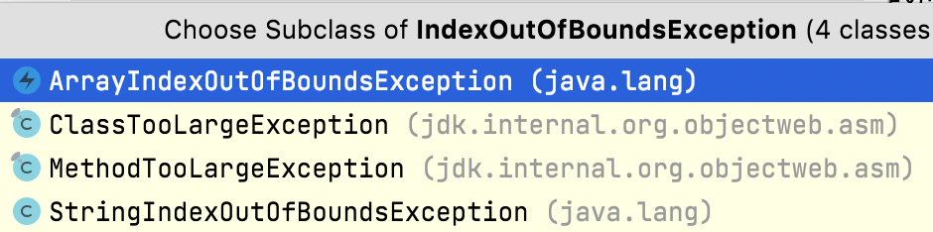




Error
VirtualMachineError
LinkageError
AssertionError
Object
RuntimeException
ClassCastException
Throwable
ArithmeticException
SQLException
IllegalArgumentException
InterruptedException
NullPointerException
IOException
IndexOutOfBoundsException
Exception
ParseException

Slide 3

Thank You !
momedaram

